Slide 1
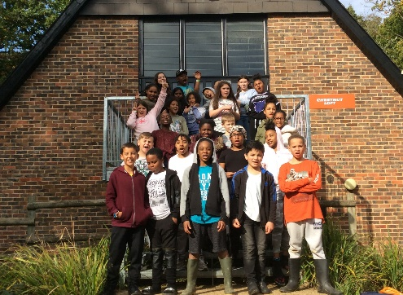
Attendance Champions
First half term
1st Place – Y5 Beech Class 97.7%:
2nd Place : Y6 Oak Class:97.1%
3rd Place : YR Cherry Class 97.0%
4th Place: Y3 Pine Class 96.7%
5th Place: Y4 Maple Class 96.0%
6th Place: Y2 Ash Class 95.0%
7th Place: Y1 Willow Class 94.9%
Well done Beech Class!
Remember- our target is 96.5%
Keep our children safe
A polite reminder-please do not park or drop off on the zigzag lines outside school. We all need to drive considerately to ensure our children can cross the road in safety.
What’s been happening?
Both Miss Kennard and Mrs Dubben have welcomed teachers from other schools for continued maths training as leads for Thames Maths Hub. This puts us at the forefront of developments in maths education
Year 6 visited the Museum of London as part of their investigations into the history of London
A team from Y3 and 4 took part in a cluster tennis festival
Years 1 and 2 took part in a cross country run at Lloyd Park
Year 3 visited Pizza Express
We welcomed Pastor Nick to hold our Harvest Festival – thank you to all for your generous donations to the Food Bank
We held a very well attended open morning for prospective parents
Year 6 had a week of adventures on their residential to Carroty Wood
Coming up in November…
http://www.newvalleyprimary.com/parent-info/school-calendar/
Check out our new video on the New Valley website!
NEWS
Interim reports and parent appointments (look for the letter after half term)
Reception parents maths evening
Y1 Phonics meeting
Year 6 visits to London and the London Eye; Year 1 visit to the Tower of London; Florence Nightingale visiting Year 2
Years 1,2 and 3 assemblies…
October 2018
PTA Corner…
Well done to the PTA for their continued hard work this term. The PTA ran a Macmillan Coffee morning in September and sent a generous donation to the Macmillan Trust.
FILM NIGHT was well attended and raised £569 towards the £10000 target for furnishing the outdoor learning environment. This brings their running total to just over £6000!
Next Event:
Fancy Dress Disco Friday 2nd November- an event where all the family can dress up and have some fun!
The PTA is recruiting helpers for the Christmas Fair (14th Dec) . Please see your class rep or the new PTA Chair, Hannah Davies, if you can help.
Our Stars of the Week- nominated for going above and beyond expectations…
Week 1: Anthony (Y1), Patrick (Y2) Reece (Y3) Maria-Rose (Y4) Jeremiah (Y5) and Thomas (Y6)
Week 2: Mason (R) Shanaiyah (Y1) Paige (Y2) Mateo (Y3) Muhammad (Y4) Noah (Y5) Olivia (Y6)
Week 3: Alem ® Jorja (Y1) Elsie (Y2) Amy (Y3) T’hanna (Y4) Elle- Savannah (Y5) Aaniyah (Y6)
Week 4: Ellie- Mae (R) Jenson(Y1) Bella (Y2) Aiva- Milan(Y3) Jake (Y4) Kelvin (Y5) Aliyah (Y6)
Week 5: Leo (R) Rome (Y1) Zian (Y2) Jay (Y3) Omar (Y4) Ori (Y5) Team 6
Week 6: Akeylah (R) Ahmed (Y1) Isaiah (Y2) Lukas (Y3) Year 4 Year 5 and Team 6
And finally… Thank you to all our families for their continued support. Have a lovely, safe half term break and we look forward to seeing you all again on
Monday, 29th October.

