Slide 1
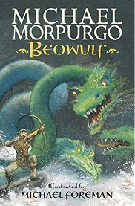
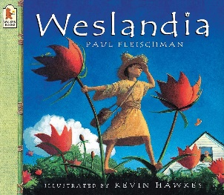
Maths:
As mathematicians we will be:
Compare, order and round decimals
Covert pounds and pence to help and add and subtract money.
Recognise and describe 2D shapes including symmetry and angles.
Interpret graphs
Draw and input data onto a line graph
English writing texts:
Mrs Pickard
Summer 2022
History / Geography:
As historians we will be:
Place events in chronological order from the history they know so far up to and including the Vikings
Use evidence to show what life was like during the Viking era
Understand what Vikings ate and make a similar dish
As geographers we will be:
Understand the consequences of Global warming
Research and identify various solutions and their impact on society and the environment
Science:
As scientists we will be:
Comparing materials according to whether they are a solid, liquid or gas.
Observe how materials change state
Define evaporation and condensation
Understand the water cycle.
Reading:
Spanish
In Spanish we will be:
Speaking and reading foods and drinks
Creating a Spanish menu using Microsoft Publisher
Cooking a Spanish delicacy
Art:
As artists we will explore line and tone. Discuss the reasons to why we choose a specific material or tool. Have an increasing awareness of composition, background as well as the effects of light and dark.
Music:
In music we will be using the app Garage Band and compose music for a Summer Festival
PE:
In PE we will be:
Practising our athletics skills - jumping, running and throwing.
Striking and fielding in rounders.
Children should come to school wearing a New Valley PE kit on Monday and Friday.
Computing
In Computing we will be:
- Taking photos and editing them
- Programming a game on Scratch
RE:
We will be learning about Ascension and Pentecost

